Slide 1
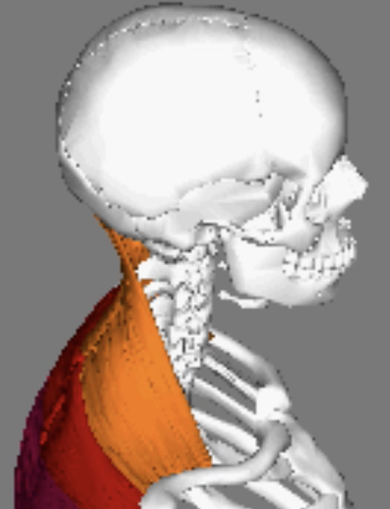
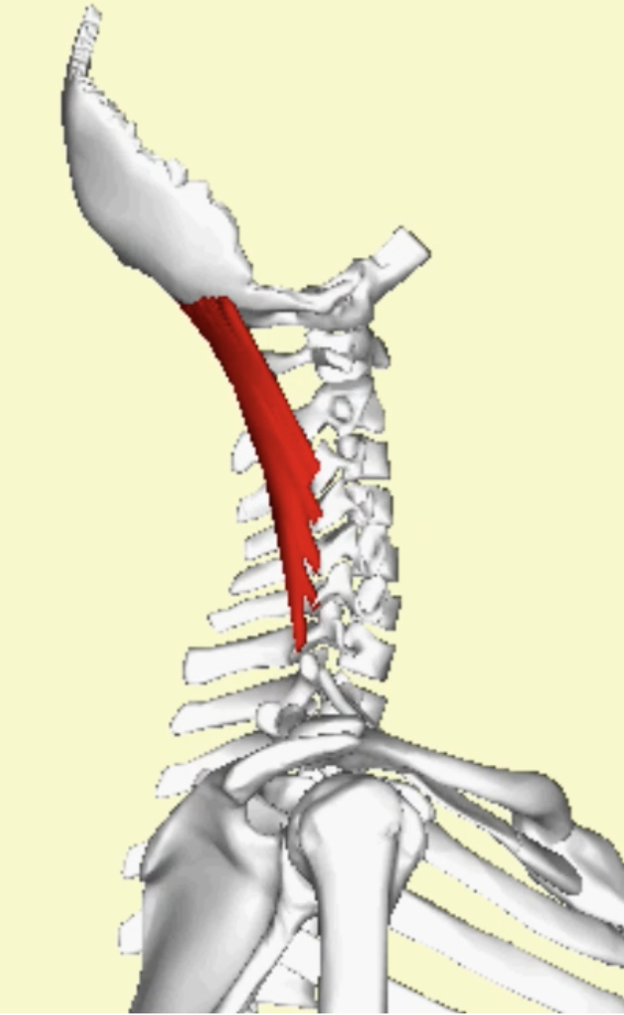
https://www.slideshare.net/ntkhab24/atlantoaxial-and-occipital-joint
W
M

Slide 2
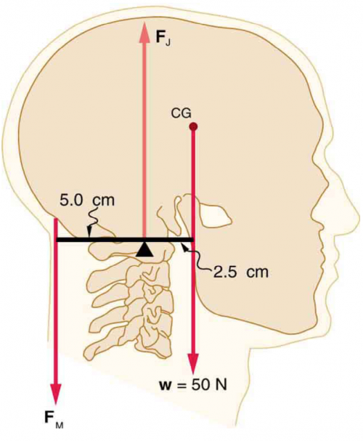
r⟂
r
r
r⟂

Slide 3
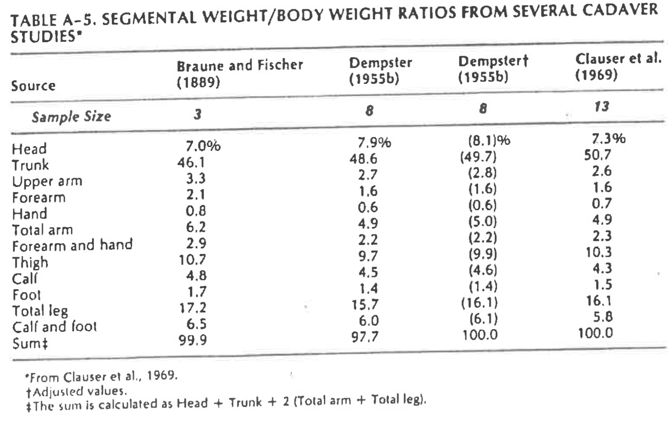

Slide 4
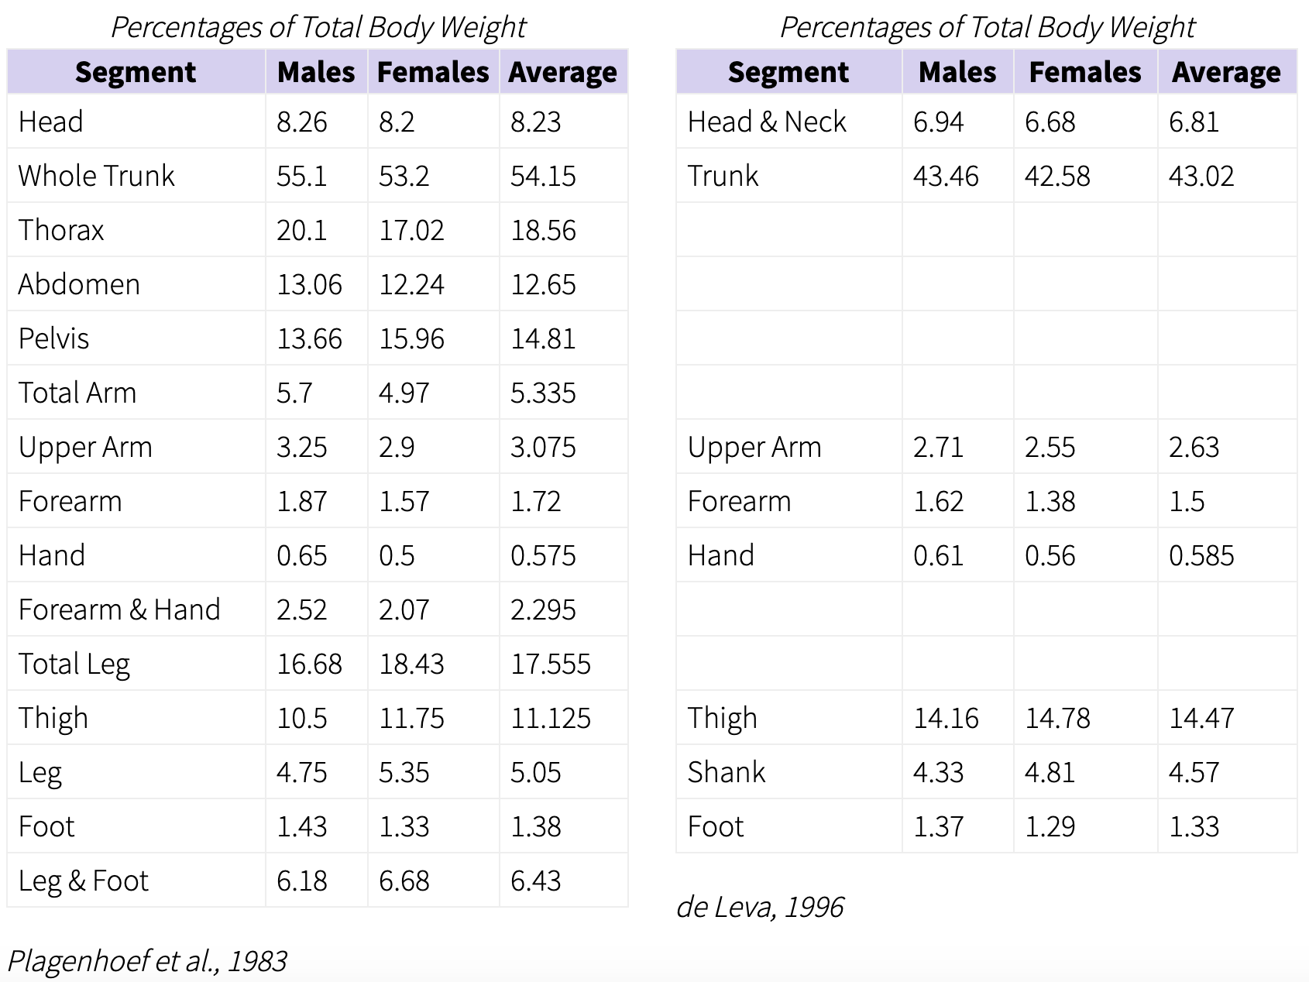
w_{body} = ?
w_{head} = ?
https://exrx.net/Kinesiology/Segments

Slide 5
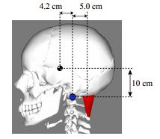
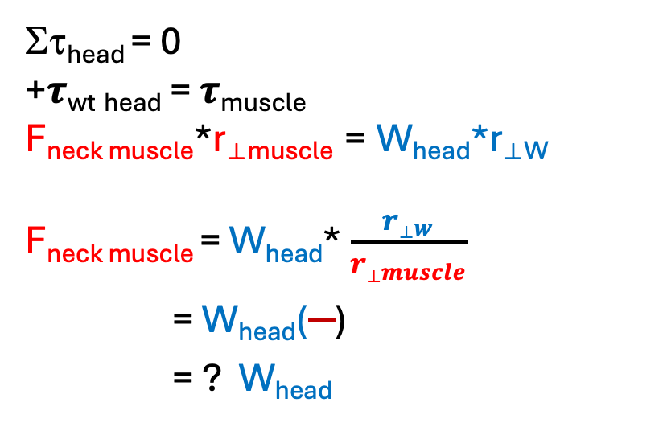
Estimate force of neck muscle, by ratio of lever arms
“Limb” system: head
Joint: Atlanto-occipital joint
r⟂
Στ_{head} = 0
+𝝉_{wt} _{head} = 𝝉_{muscle}
F_{neck muscle}*r_{⟂muscle} = W_{head}*r_{⟂W}
F_{neck muscle} = W_{head}* $\frac{{r⟂}_{w}}{{r⟂}_{muscle}}$
= W_{head}()
= ? W_{head}
r⟂
Estimate weight of head: W_{head} = ?
F_{neck muscle} = ?

Slide 6
Estimate joint force
ΣF_{head} = 0
-W_{head} -F_{muscle}+J = 0
J = W_{head}+ F_{muscle}
J = W_{head}+ ? W_{head}
J = ?? W_{head}
Estimate weight of head: W_{head} = ?
J = ?

